Slide 1





Slide 2
INSTRUCTION
Instruction is command which is given by the user to computer.
A program residing in the memory unit of a computer consists of a sequence of instructions.
These instructions are executed by the processor by going through a cycle for each instruction.

Slide 3
Instruction cycle
The time required for the fetching and execution of one simple machine instruction is the CPU cycle. It is also known as an instruction cycle.
Each instruction is further divided into sequence of phases.
After the execution the program counter is incremented to point to the next instruction.
■
■
■

Slide 4
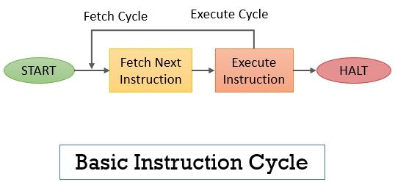

Slide 5
Phases
In a basic computer, each instruction cycle consists of the following phases:
Fetch instruction from memory.
Decode the instruction.
Read the effective address from memory.
Execute the instruction.

Slide 6
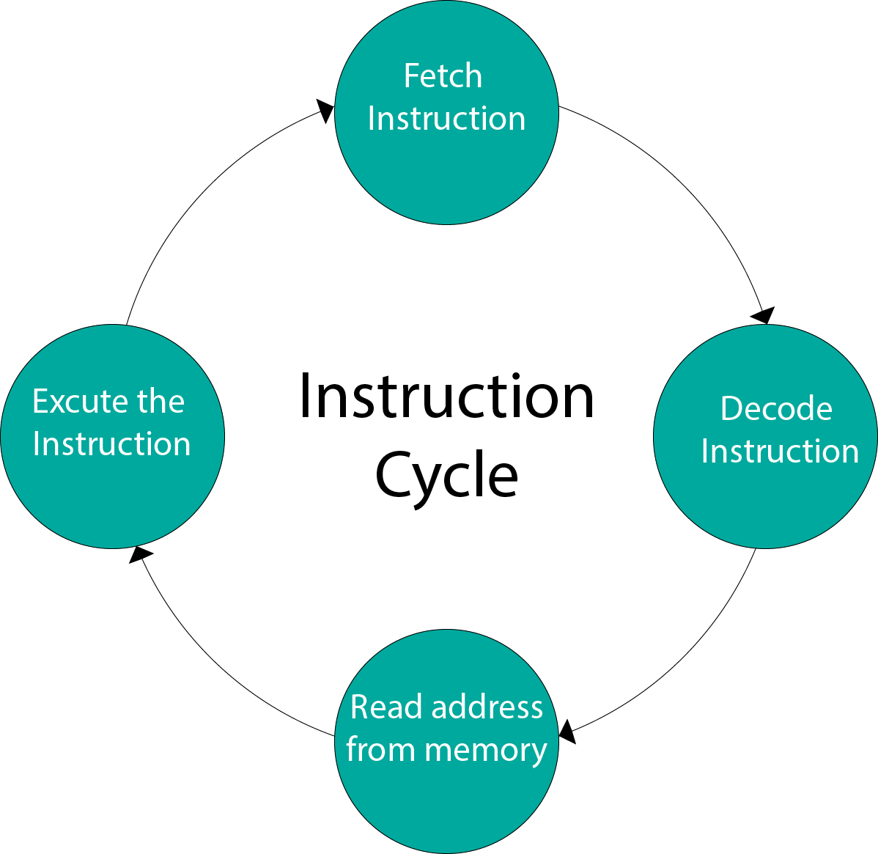

Slide 7
Fetch cycle
In this phase the sequence counter is initialized to 0.
The address of first instruction from PC is loaded into address register during the first clock cycle.
■
■

Slide 8
Fetch cycle
Mov AC, 0
0000
0001
0002
0003
PC
0002
AC
Mov AC, 0
Execute
Decode unit
IR
unit

Slide 9
Decode cycle
The instruction is decoded by the instruction decoder of a processor.
All the bits of the instruction under execution stored in IR are analyzed and decode in third clock cycle.

Slide 10
Decode cycle
Mov AC, 0
0000
0001
0002
0003
PC
0002
AC
Mov AC,0
Execute
Decode unit
IR
unit

Slide 11
Execute cycle
In the last phase, the processor execute the instruction.
This involves setting the contents of the internal register AC to constant value 0.
■
■

Slide 12
Execute cycle
Mov AC, 0
0000
0001
0002
0003
PC
0003
AC
 | Mov AC,0
AC 0
Execute unit
Decode unit
IR

Slide 13
SC 0
AR
PC
IR M[AR], PC PC+1
Decode IR(12-14) I IR(15), AR IR(0-11)
I/O or reg. reference 1=
=0 Memory reference
D
0=
=1
0=
=1
I
I
Nothing
AR M[AR]
Execute reg. reference
Execute I/O reference
Execute memory reference
Execute memory reference

Slide 14
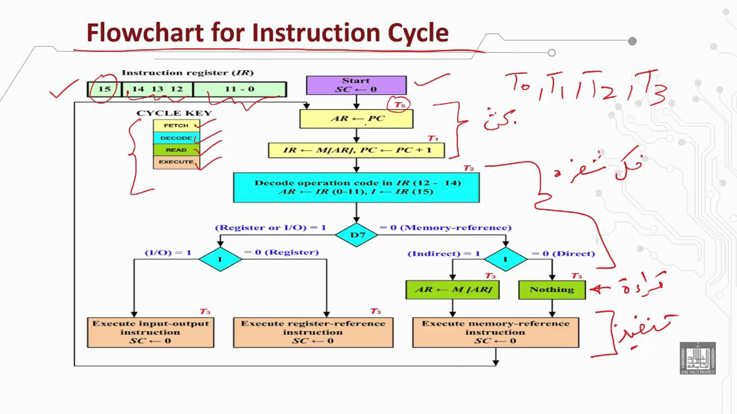

Slide 15
Fetch operation
■
The circuit comprises of various registers, memory unit I/O devices, control and timing unit ALU and a common bus.
■
AR PC
IR M[AR], PC PC+1
■
■
The instruction read from memory is then placed in the instruction register.

Slide 16
Decode operation
In decode operation processor decode the instruction which is fetched from memory.
■
I IR(15), Decode IR(12-14) AR IR(0-11)
0-11 bits in the instruction format are store in the address register.
12-14 bits are decoded.
15 bit is I means direct or indirect address.
■
■
■

Slide 17
Execution Operation
■
After decoding the instruction, the timing signal that is active.
There are three types of instruction:-
Memory Reference
Register Reference
I/O Reference
If D=1 and IR(15)=0, that means the instruction is register reference.
If d=1 and IR(15)=1, that means the instruction is I/O reference.
■
■
■

Slide 18
Execution Operation
■
If D=0 and IR(15)=0, that means memory reference instruction is direct address instruction.
If D=0 and IR(15)=1, that means memory reference instruction is indirect address
■
instruction.
■
AR M[AR], AR holds the address part of the instruction
■
After the instruction is executed, SC is cleared to 0 and control returns to the fetch phase.

Slide 19


